Slide 1


IOT Enabled Prototyping
Subject Code: 22IEP38
St Joseph Engineering College – Mangaluru.
An Autonomous Institution
Automatic Plant Watering System
Guided by
Prasad S M
CLASS- 3rd SEM SECTION: A BRANCH:ECE

Slide 2
TEAM INFO
TEAM LEADER :
S.NO | NAME | USN
1 | Frenny Chrystal Saldanha | 4SO23EC028
2 | Hani Mohammed Kaif | 4SO23EC034
3 | Mohammed Shaheed | 4SO23EC059
4 | Mohammed Thaha | 4SO23EC060
5 | Moosah Mohammed Aqeel | 4SO23EC061

Slide 3
Introduction :
We the members of group 7 are hereby presenting an AUTOMATIC PLANT WATERING SYSTEM .
This system is very beneficial for all the people who are a great enthusiasts of gardening but they are not able to do it because of their hectic schedule.
So here we are presenting you a most convenient method of watering your plants effortlessly using modern technology of science.
We have also made sure to check the soil moisture for proper amount of water to be watered to the plants and no harm is caused to our most beautiful assets (plants).

Slide 4
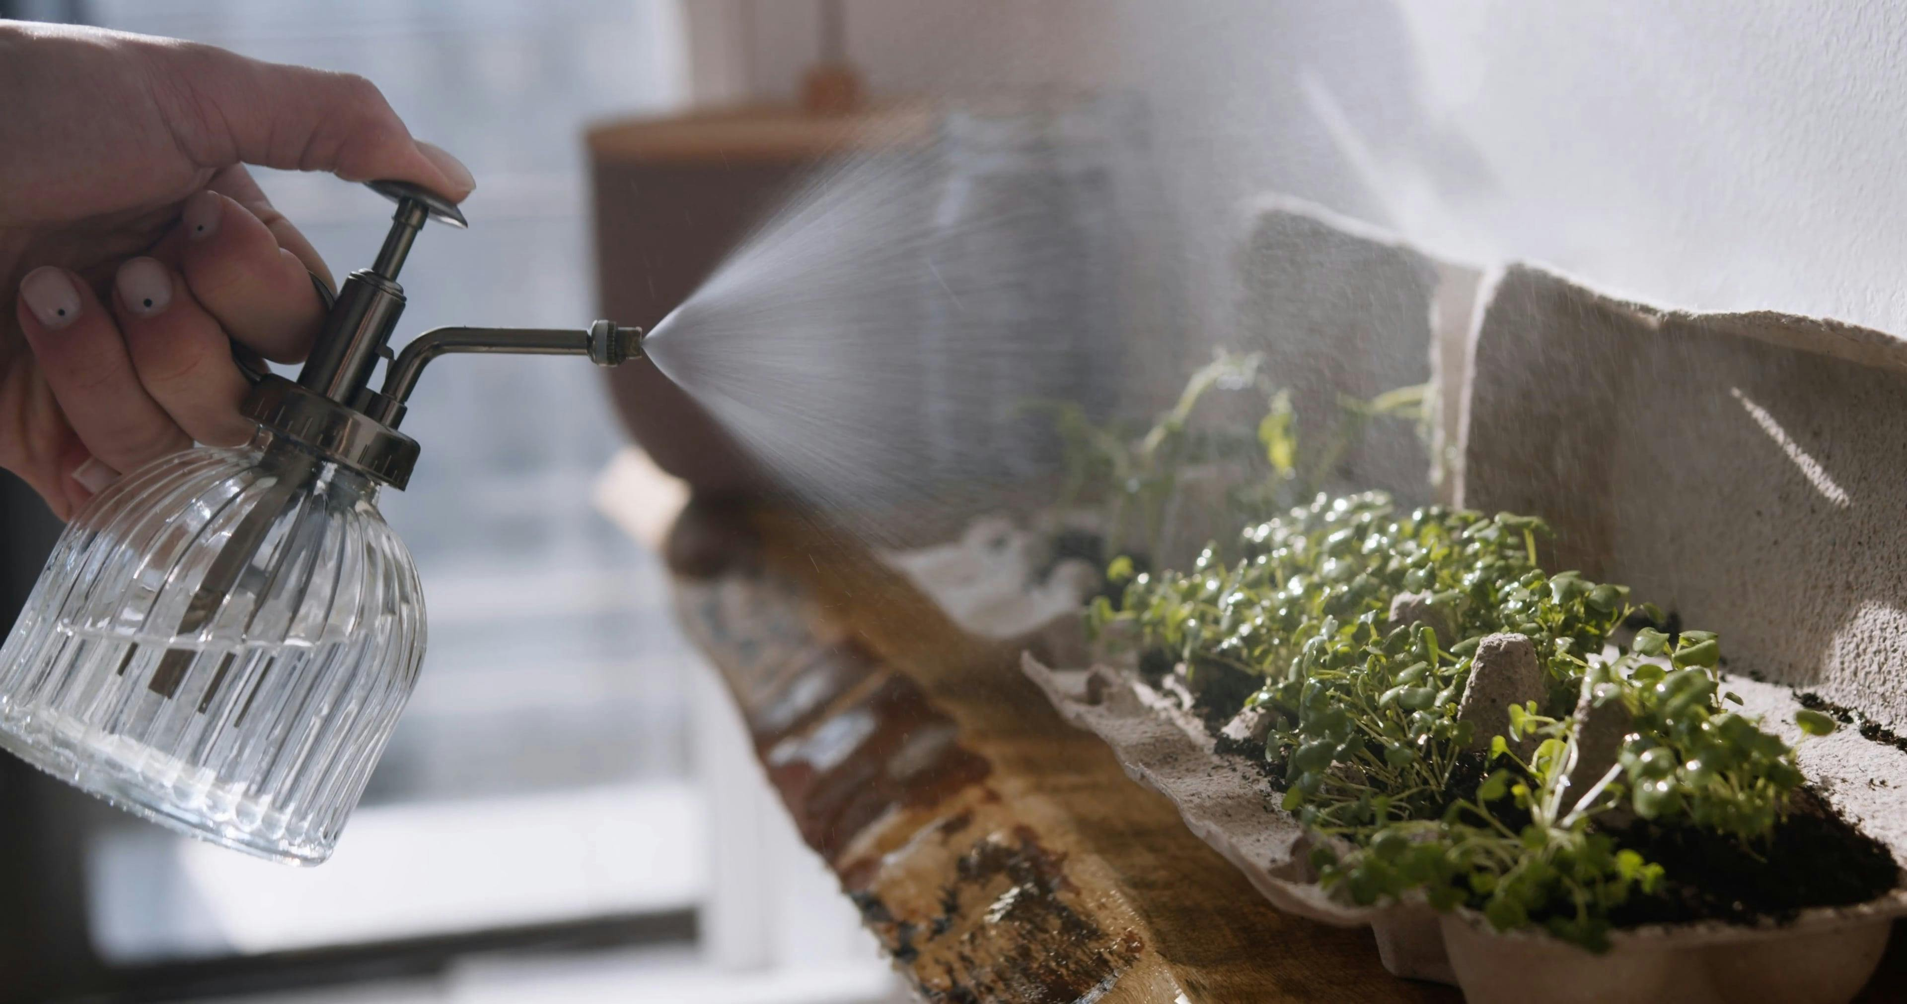
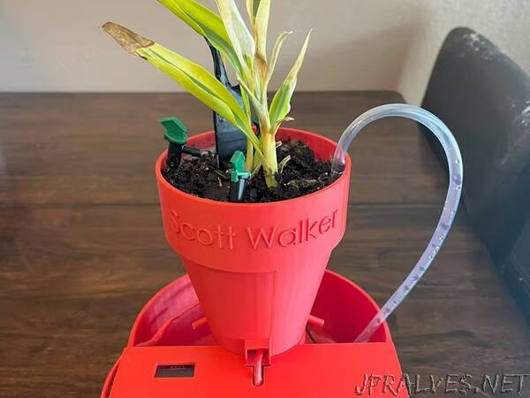
Objectives
1. Consistent Watering 5.Convenience
Even moisture distribution Less manual effort
Prevents over or under-watering
2. Time-Saving 6.Enhanced property aesthetics
Great for busy individuals
3. Water Conservation 7.Increase plant growth
Efficient water use
Eco-friendly
4. Improved Plant Health 8.Ideal for people who love to travel
Prevents stress
Better root development
This Photo by Unknown Author is licensed under CC BY-NC-ND

Slide 5
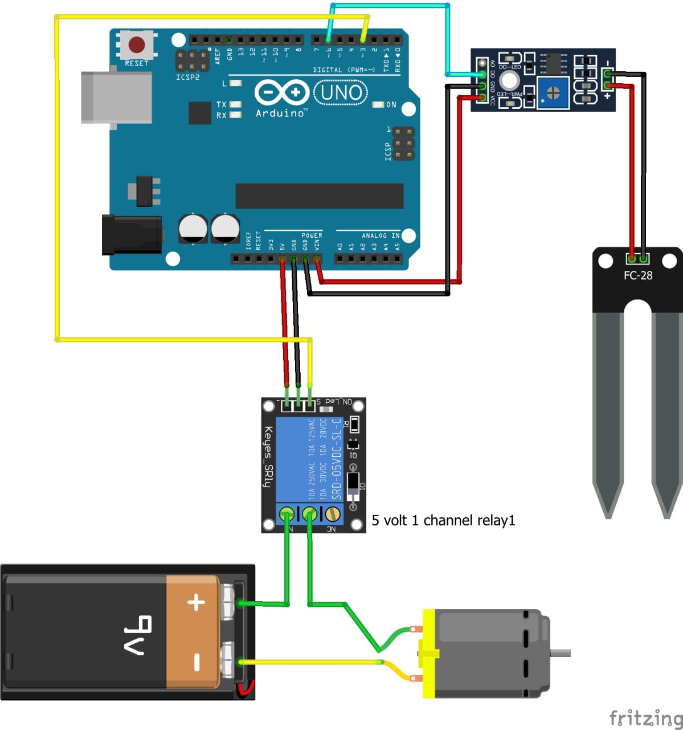
Figurative Representation of the project model

Slide 6
Operation of the project
The goal of the system is to automate the process of watering your plants by monitoring the moisture content of the soil. The system will trigger a water pump (driven by a mini motor) to water the plant only when the soil moisture drops below a specified threshold. The key components of the system include:
Moisture Sensor: Measures the water content in the soil.
Relay Module: Controls the water pump based on the signal received from the Arduino.
Arduino Uno: Processes sensor data and controls the relay and motor.
Mini Motor (Water Pump): Used to pump water into the soil when needed.

Slide 7
Program
int water;
void setup() {
pinMode(3,OUTPUT);
pinMode(6,INPUT);
}
void loop() {
water = digitalRead(6);
if(water == HIGH)
{
digitalWrite(3,LOW);
}
else
{
digitalWrite(3,HIGH);
}
delay(400);
}

Slide 8
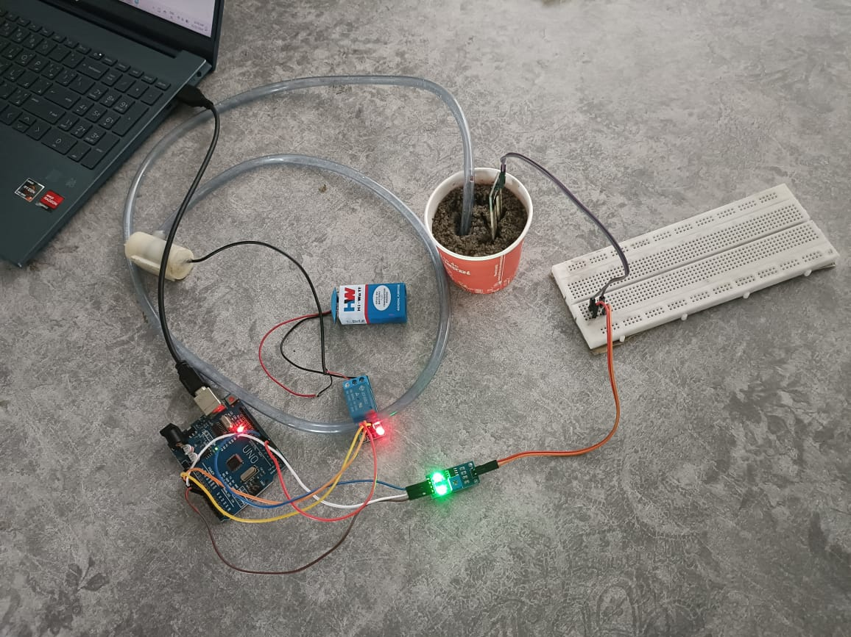
Final Project Model

Slide 9
Results and Discussion
The automatic plant watering system worked successfully, meeting the project's objectives of providing efficient, on-demand watering based on soil moisture content. The system demonstrated reliability in detecting dry soil conditions and activating the water pump accordingly. Additionally, it proved to be energy-efficient, thanks to its periodic checking mechanism.
With some improvements in sensor calibration, system flexibility, and remote monitoring, the system could be further optimized for diverse plant species and larger-scale applications. Overall, the project provides a solid foundation for an automated irrigation system that can be adapted for various gardening and agricultural needs.

Slide 10
Future Scope
In the future, we can modify our system using mobile applications to control the watering of the plants.
Also we can install a weather forecasting system which helps us to know how’s the weather going to be and accordingly we can water the plants.
We can also prevent soil erosion by modifying our soil moisture sensor for higher applications.
Our model is designed for a small scale gardening use but if we have proper resources and guidance we can also install it for large agricultural fields which can simplify farming and also yield abundantly.

Slide 11


